Slide 1
SQL PROJECT
Student: Swetha B. Singh
Course: Data Science guaranteed placement
Course content: SQL
Submitted date: 05-09-2023

Slide 2
Index Page No
Create ipl_ball file & Import database …………………………………… 2
Create ipl_matches & Import database…………………………………… 3
Final Project Questions
Question 1. Bidding of Batters…………………………………….............4
Question 2. Good average and played 2 ipl………………………..............5
Question 3. Hard-hitting players………………….......................................6
Question 4. Bidding on Bowlers………........................................................7
Question 5. Bowlers strike rate …………….................................................8
Question 6. All-rounders................................................................................9
Question 7. Wicket-Keepers Criteria………………………………….........10-11
Additional Questions
Copying file ipl_ball to deliveries………………………………………….12
Copying file ipl_matches to matches………………………………………13
Question 1………………………………………………………………….14
Question 2………………………………………………………………….15
Question 3………………………………………………………………….16
Question 4………………………………………………………………….17

Slide 3
Index Page No
Question 5………………………………………………………………….17
Question 6………………………………………………………………….18
Question 7………………………………………………………………….19
Question 8………………………………………………………………….20
Question 9………………………………………………………………….21
Question 10……………………………………………………………..….22
Final Project Files Additional Question Files
Question-1.csv 1. Add-Ques-02
Question-2.csv 2. Add-Ques-04
Question-3.csv 3. Add-Ques-05
Question-4.csv 4. Add-Ques-07
Question-5.csv 5. Add-Ques-08
Question-6.csv 6. Add-Ques-09
7. Add-Ques-10

Slide 4
Steps to start to Complete the project
Create File ipl_ball
create table ipl_ball(
id int,
innings int,
over int,
ball int,
batsman varchar(255),
non_striker varchar(255),
bowler varchar(255),
batsman_runs int,
extra_runs int,
total_runs int,
is_wicket int,
dismissal_kind varchar(255),
player_dismissed varchar(255),
fielder varchar(255),
extras_type varchar(255),
batting_team varchar(255),
bowling_team varchar(255)
)
Import data to PGAdmin
copy ipl_ball from 'D:\Internshala\SQL\Data\Final Project-IPL Dataset\ipl_ball.csv' delimiter ','csv header;

Slide 5
Steps to start to Complete the project
Create File ipl_matches
create table ipl_matches(
id int,
city varchar(255),
date date ,
player_of_match varchar(255),
venue varchar(255),
neutral_venue int,
team1 varchar(255),
team2 varchar(255),
toss_winner varchar(255),
toss_decision varchar(255),
winner varchar(255),
result varchar(255),
result_margin int,
eliminator varchar(255),
method varchar(255),
umpire1 varchar(255),
umpire2 varchar(255)
)
Import data to PGAdmin
copy ipl_matches from 'D:\Internshala\SQL\Data\Final Project-IPL Dataset\ipl_matches.csv' delimiter ','csv header;

Slide 6
QUESTION-1
BIDDING ON BATTERS
Your first priority is to get 2-3 players with high S.R who have faced at least 500 balls.And to do that you have to make a list of 10 players you want to bid in the auction so that when you try to grab them in auction you should not pay the amount greater than you have in the purse for a particular player.
(strike rate is total runs scored by batsman divided by number of balls faced but remember when extras_type is 'wides' it is not counted as a ball faced neither counted as batsmen runs)
CSV FILE NAME-Ques-01
QUERY
select batsman,
count(ball) as total_balls,
sum(batsman_runs) as total_runs,
cast(sum(batsman_runs)as decimal) / count(ball) *100 as Strick_rate
from ipl_ball
where extras_type <> 'wides'
group by batsman
having count(ball) >= 500
order by Strick_rate desc
limit 10 ;

Slide 7
QUESTION-2
GOOD AVERAGE AND PLAYED 2 IPL
Now you need to get 2-3 players with good Average who have played more than 2 ipl seasons. And to do that you have to make a list of 10 players you want to bid in the auction so that when you try to grab them in auction you should not pay the amount greater than you have in the purse for a particular player.
(Average is calculated as total runs scored divided by number of times batsman has been dismissed which can be calculated using wicket_ball field as 1 indicates out and 0 indicates not out, a batsman should’ve been dismissed at least once to calculate the sr i.e., you can exclude those players who have not been dismissed once )
CSV FILE NAME-Ques-02
QUERY
select
a.batsman,
sum(a.total_runs) as totalruns,
sum(a.is_wicket) as total_wickets,
count(distinct(extract(year from b.date))) as seasons,
sum(batsman_runs)* 1.0/sum(is_wicket) as avg
from ipl_ball as a
left join ipl_matches as b
on a.batsman_id=b.batsman_id
group by batsman
having count(distinct(extract(year from b.date))) > 2
order by avg desc
limit 10;

Slide 8
QUESTION-3
HARD-HITTING PLAYERS
Now you need to get 2-3 Hard-hitting players who have scored most runs in boundaries and have played more the 2 ipl season. To do that you have to make a list of 10 players you want to bid in the auction so that when you try to grab them in auction you should not pay the amount greater than you have in the purse for a particular player.
(Only 4 and 6 will be counted as boundaries so calculate how many 4 and 6 has been hit by each batsman and also calculate total runs scored to get the output as boundary percentage which will be runs in boundary divided by total runs scored)
QUERY
select
a.batsman,
count(distinct(extract(year from date))) as seasons,
sum(batsman_runs) as total_runs,
count(batsman_runs > 4 and batsman_runs<6) as total_boundaries,
round(((b.total_runs)*1.0/sum(a.batsman_runs))*100,2) as boundary_percentage
from deliveries_01 as a
join (select batsman,
sum(batsman_runs)as total_runs
from deliveries_01
where batsman_runs between 4 and 6
group by batsman) as b
on a.batsman=b.batsman
group by a.batsman,b.total_runs
having count(distinct(extract(year from date)))>2
order by boundary_percentage desc
limit 10;
CSV FILE NAME-Ques-03

Slide 9
QUESTION-4
BIDDING ON BOWLERS
Your first priority is to get 2-3 bowlers with good economy who have bowled at least 500 balls in IPL so far.To do that you have to make a list of 10 players you want to bid in the auction so that when you try to grab them in auction you should not pay the amount greater than you have in the purse for a particular player. (economy can be calculated by dividing total runs conceded with total overs bowled)
CSV FILE NAME-Ques-04
QUERY
select
bowler,
count(bowler) as total_bowler,
sum(total_runs) as total_run,
(sum(total_runs)/(count(bowler)/6.0)) as economy
from ipl_ball
group by bowler
having count(bowler)>=500
order by economy desc
limit 10;

Slide 10
QUESTION-5
BOWLERS STRIKE RATE
Now you need to get 2-3 bowlers with the best strike rate and who have bowled at least 500 balls in IPL so far.To do that you have to make a list of 10 players you want to bid in the auction so that when you try to grab them in auction you should not pay the amount greater than you have in the purse for a particular player. (strike rate of a bowler can be calculated by number of balls bowled divided by total wickets taken )
CSV FILE NAME-Ques-05
QUERY
select
bowler,
count(ball) as total_balls,
sum(is_wicket) as total_wicket,
count(ball)/sum(is_wicket)as strike_rate
from ipl_ball
group by bowler
having count(bowler)>=500
order by strike_rate desc
limit 10;

Slide 11
QUESTION-6
ALL ROUNDERS
Now you need to get 2-3 All_rounders with the best batting as well as bowling strike rate and who have faced at least 500 balls in IPL so far and have bowled minimum 300 balls.To do that you have to make a list of 10 players you want to bid in the auction so that when you try to grab them in auction you should not pay the amount greater than you have in the purse for a particular player.
( strike rate of an all rounder can be calculated using the same criteria of batsman similarly the bowling strike rate can be calculated using the criteria of a bowler)
CSV FILE NAME-Ques-06
QUERY
select
batsman,
(sum(total_runs)/count( ball)) as batting_rate,
(sum(is_wicket)/count(distinct ball)) as bowling_rate,
sum(ball) as total_ball,
count(ball)as ball_faced
from deliveries_01
group by batsman
having count(ball)>= 300 and count( ball) >= 500
order by batting_rate desc, bowling_rate desc
limit 10 ;

Slide 12
WICKET-KEEPER CRITERIA
In cricket, the most important role is played by the wicketkeeper. The Wicket-keeper is the one person in the field who wears gloves and stands exactly behind the wickets. A good batter is demanded of a wicketkeeper. Throughout a game, they are the only players on the field to touch every ball. A wicketkeeper’s average is higher than a specialist bowler’s average at the highest level.
Wicketkeepers must have a good knowledge of cricket rules related to run-outs, stumps, and fielding restrictions. Communication between the team members must be good with each ball. Wicket-Keeper should know the move of the bowler and batsman, what is the ball pitch and in which way the batsman bats the ball.
Wicket-keeper must have the catching ability, Team Skills, and Fitness. A wicketkeeper must be able to catch the ball in various situations and in different positions like Diving Forward, Stumps, and Standing Back. He should have hand-eye coordination and concentration on each ball. For each ball, he/she has to squat down and get up when the ball comes.
A good wicketkeeper should know some skills like
Quick Response: Wicket-keepers need quick reflexes to respond to deliveries that can differ in velocity and bounce. When facing the stumps or when the ball is moving suddenly, quick thinking is crucial.
Stamina: Where a wicket-keeper may spend a lot of time behind the stumps, wicket-keeping can be physically taxing. To maintain focus throughout lengthy innings, endurance and fitness are essential.

Slide 13
WICKET-KEEPER CRITERIA
Prediction: A proficient wicketkeeper is able to predict the batsman's actions and the bowler's deliveries. Positioning and responding to anticipated edges or stumping are made easier with this prediction.
Pitch Condition: A wicket-keeper's effectiveness depends on their ability to comprehend the weather and pitch conditions and how they may affect the ball's movement.
Flexibility: A wicketkeeper needs to possess a variety of talents depending on the type of cricket being played (Test, One-Day, T20). They must be flexible enough to accommodate various game scenarios and formats.

Slide 14
ADDITIONAL QUESTIONS FOR FINAL ASSESSMENT
Copying ipl_ball table to deliveries table
Copying ipl_matches table to matches table
QUERY
create table deliveries as select * from ipl_ball;
QUERY
create table matches as select * from ipl_matches;

Slide 15
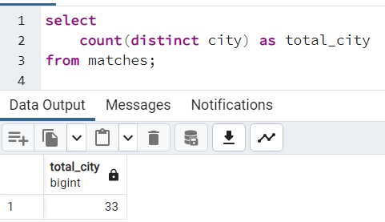
ADDITIONAL QUESTIONS - 1
1. Get the count of cities that have hosted an IPL match
QUERY
select
count(distinct city) as total_city
from matches;

Slide 16
ADDITIONAL QUESTIONS - 2
2. Create table deliveries_v02 with all the columns of the table ‘deliveries’ and an additional column ball_result containing values boundary, dot or other depending on the total_run
(boundary for >= 4, dot for 0 and other for any other number)
(Hint 1 : CASE WHEN statement is used to get condition based results)
(Hint 2: To convert the output data of the select statement into a table, you can use a
subquery. Create table table_name as [entire select statement].
CSV FILE NAME-Add-Ques-02
QUERY
select *,
(case when total_runs > 4 then 'boundary'
when total_runs = 0 then 'dot'
else 'others' end) as ball_result
from deliveries;
Create deliveries_v02 table
create table deliveries_v02 as (select *,
(case when total_runs > 4 then 'boundary'
when total_runs = 0 then 'dot'
else 'others' end) as ball_result
from deliveries);

Slide 17
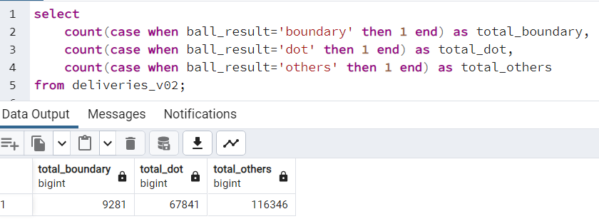
ADDITIONAL QUESTIONS - 3
3. Write a query to fetch the total number of boundaries and dot balls from the deliveries_v02 table.
QUERY
select
count(case when ball_result='boundary' then 1 end) as total_boundary,
count(case when ball_result='dot' then 1 end) as total_dot,
count(case when ball_result='others' then 1 end) as total_others
from deliveries_v02;

Slide 18
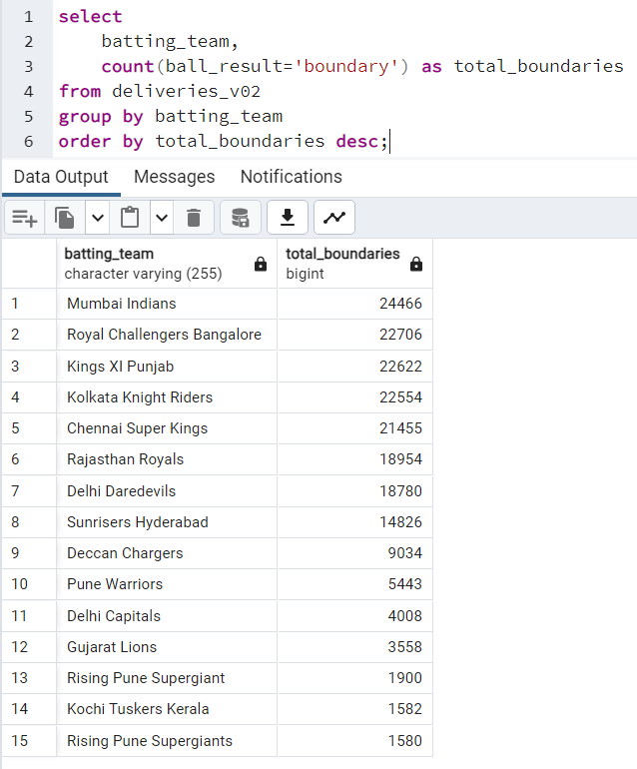
ADDITIONAL QUESTIONS - 4
4. Write a query to fetch the total number of boundaries scored by each team from the deliveries_v02 table and order it in descending order of the number of boundaries scored.
CSV FILE NAME-Add-Ques-04
QUERY
select
batting_team,
count(ball_result='boundary') as total_boundaries
from deliveries_v02
group by batting_team
order by total_boundaries desc;

Slide 19
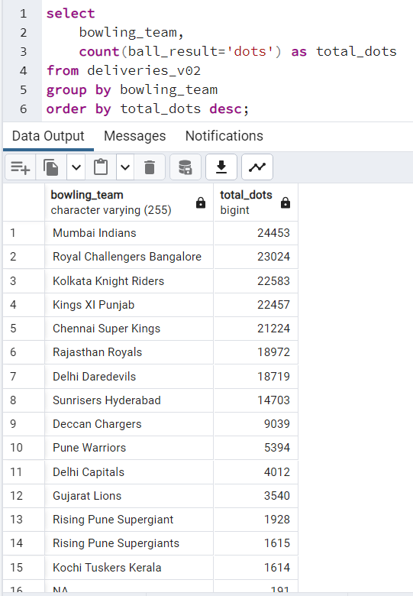
ADDITIONAL QUESTIONS - 5
5. Write a query to fetch the total number of dot balls bowled by each team and order it in descending order of the total number of dot balls bowled.
CSV FILE NAME-Add-Ques-05
QUERY
select
bowling_team,
count(ball_result='dots') as total_dots
from deliveries_v02
group by bowling_team
order by total_dots desc;

Slide 20
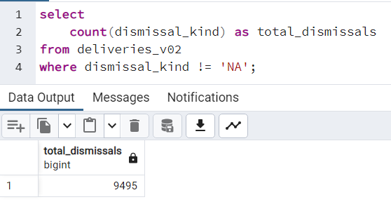
ADDITIONAL QUESTIONS - 6
6. Write a query to fetch the total number of dismissals by dismissal kinds where dismissal kind is not NA
QUERY
select
count(dismissal_kind) as total_dismissals
from deliveries_v02
where dismissal_kind != 'NA';

Slide 21
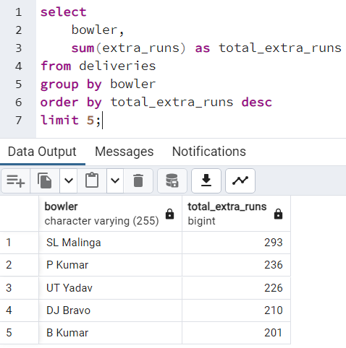
ADDITIONAL QUESTIONS - 7
7. Write a query to get the top 5 bowlers who conceded maximum extra runs from the deliveries table
CSV FILE NAME-Add-Ques-07
QUERY
select
bowler,
sum(extra_runs) as total_extra_runs
from deliveries
group by bowler
order by total_extra_runs desc
limit 5;

Slide 22
ADDITIONAL QUESTIONS - 8
8. Write a query to create a table named deliveries_v03 with all the columns of deliveries_v02 table and two additional column (named venue and match_date) of venue and date from table matches
CSV FILE NAME-Add-Ques-08
QUERY
select
a.*,
b.venue,
b.date as match_date
from deliveries_v02 as a
left join matches as b
on a.batsman_id=b.batsman_id;
QUERY TO CREATE ‘deliveries_v03’ TABLE
create table deliveries_v03 as (select
a.*,
b.venue,
b.date as match_date
from deliveries_v02 as a
left join matches as b
on a.batsman_id=b.batsman_id);

Slide 23
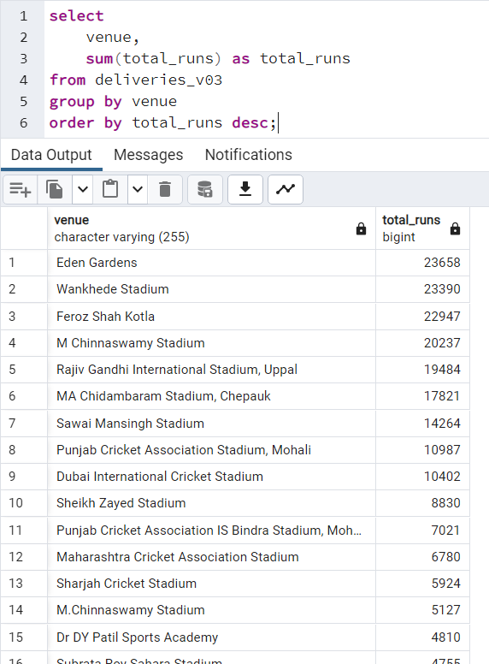
ADDITIONAL QUESTIONS - 9
9. Write a query to fetch the total runs scored for each venue and order it in the descending order of total runs scored.
CSV FILE NAME-Add-Ques-09
QUERY
select
venue,
sum(total_runs) as total_runs
from deliveries_v03
group by venue
order by total_runs desc;

Slide 24
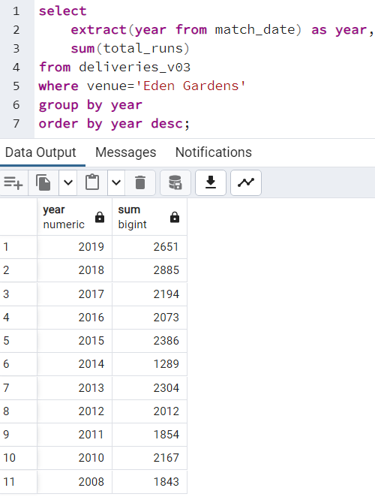
ADDITIONAL QUESTIONS - 10
10. Write a query to fetch the year-wise total runs scored at Eden Gardens and order it in the descending order of total runs scored.
CSV FILE NAME-Add-Ques-10
QUERY
select
extract(year from match_date) as year,
sum(total_runs)
from deliveries_v03
where venue='Eden Gardens'
group by year
order by year desc;

Slide 25
Final Project Files Additional Question Files
Question-1.csv 1. Add-Ques-02
Question-2.csv 2. Add-Ques-04
Question-3.csv 3. Add-Ques-05
Question-4.csv 4. Add-Ques-07
Question-5.csv 5. Add-Ques-08
Question-6.csv 6. Add-Ques-09
7. Add-Ques-10
Charts
Final Project Charts.xls

Slide 26
THANK YOU

